Slide 1
Gradus ad ACWE
Music Theory, Act I.
History and Basic Stuff
Tuesday, April 21, 2020

Slide 2
Student Needs
IT/AV
Other
PC/Mac/Tablet (phones are not recomended)
Zoom app
Webcam
Headset (highly recommended)
Mic
Staff Paper or Sketch Pad
Pencil
Piano keyboard or midi controller (optional)
Instrument
Metronome
Toilet Paper (optional)

Slide 3
Tonight’s Focus
Music notation rationale
Basic music history
Notation history and evolution
Meet our staff …
If your friend jumps off a clef …

Slide 4
Music Notation Rationale
Is this really necessary?!
Ok, but why not words?
It seems elitist
Is there any math involved?
Does reading music make me a better musician or does it hinder my creative self?

Slide 5
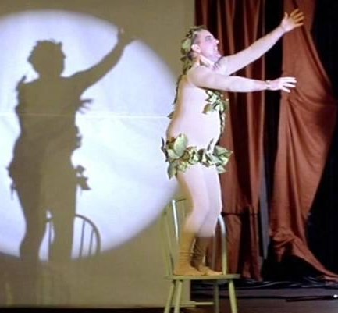
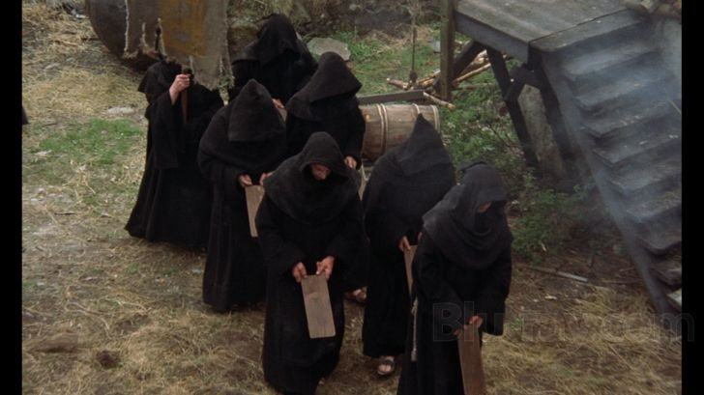
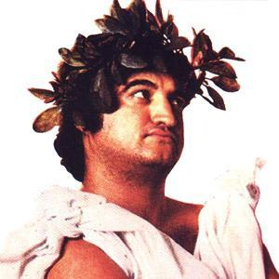
European Historical Eras (relative to music notation)
Classical Antiquity
Medieval
Modern

Slide 6
Philosophy and the Arts
Suggested Song: Philosopher’s Song – Monty Python
https://www.youtube.com/watch?v=PtgKkifJ0Pw (objectionable language warning!!)

Slide 7
Western Music after Classical Antiquity (Common Practice Period)
Suggested Song: The Decomposing Composers – Monty Python
https://www.youtube.com/watch?v=yLPQRTdkzrU

Slide 8
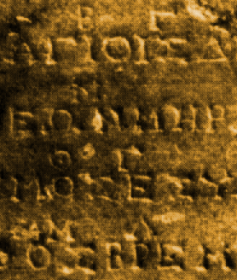
Classical Antiquity and Music Notation
Reliant on oral tradition
Mixture of written words and descriptions or instructions
Not very portable when written on stone or clay

Slide 9
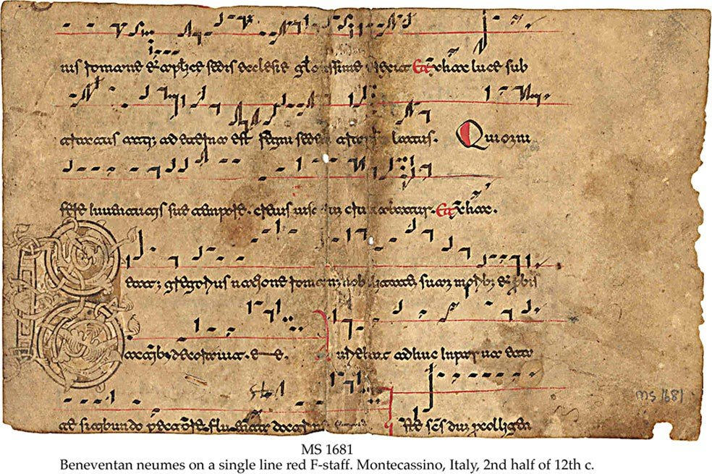
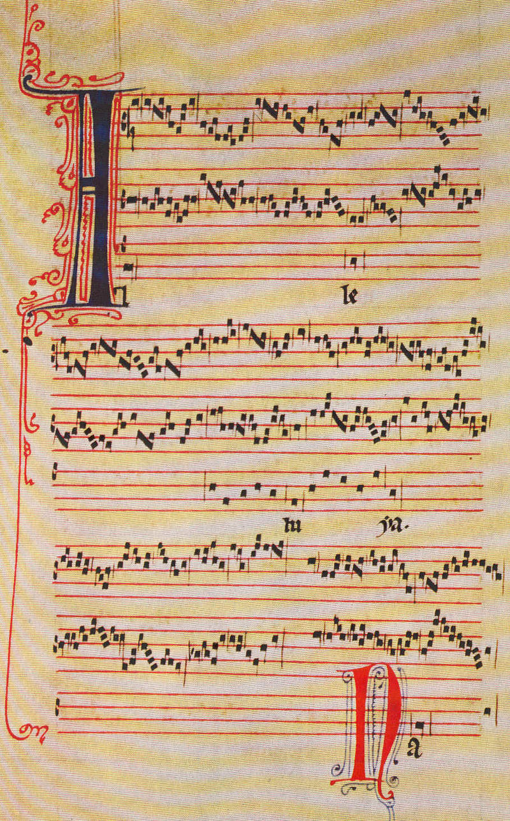
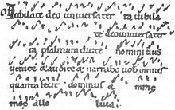
Music Notation in the Medieval Era
Liturgical Music Evolution
Early Medieval - Plainchant, Greg & Charlie
High - melismatic organum
Late -
Liber Usualis not medieval, but,,, 1896–1962 (2nd Vatican) from chants dating back to the 11th century. Notation in neumes.

Slide 10
Introducing… the staff!
x and y
Graph to denote time (speed/duration) and space (pitch)
Groups (social distance)
Organization
Pluralized as “Staves” – not “Staffs”

Slide 11
Clefs
Do is C is B and depends where you place it (3rd or 4th lines)
Fa is F is Bass Clef ?
Sol is G is Treble Clef &
Ledger Lines (not for accounting)
Let’s write these, shall we?

Slide 12
Clef mnemonics
G (treble)
Lines EGBDF
Spaces FACE
F (bass)
Lines GBDFA
Spaces ACEG

Slide 13
Oops!... Accidentals
Sharp is
Double sharp is
Flat is
Double flat is

Slide 14
Grand Staff
Used for keyboards, scores etc.

Slide 15
Registers and Octave Designations
Helmholtz
Scientific
Robert’s less-than-scientific suggestion for disambiguation

Slide 16
One thing before we go … HOMEWORK!
This will be a 2-week long homework
Please listed to the song Ida by the group Axiom of Choice and try to come up with a likely time signature. If that proves too easy, outline the thematic schema by rhythm (A, A, B, A, etc.)
Also try the song Money by Pink Floyd
Hint: neither song is in 4/4

