Slide 1
Gradus ad ACWE
Music Theory, Act II.
Pitch, Pitch, Pitch
Tuesday, April 28, 2020

Slide 2
Tonight’s Show
Quick review of clefs and staves
Sound Physics and Overtones
Just Intonation vs. Equal Temperament
Enharmonics
Basic Keyboard and Fretboard
Constructing major scales
Circle of 5ths
Order of Sharps and Flats
Notes:
Put the files in the chat box!!!!!

Slide 3
Clef Review
Do is C is B and depends where you place it (3rd or 4th lines)
Alto Clef B
Tenor Clef B
Fa is F is Bass Clef ?
Sol is G is Treble Clef &
Notes:
Test test

Slide 4
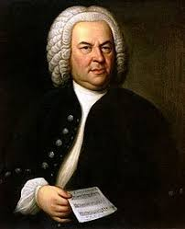
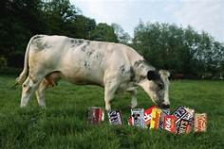
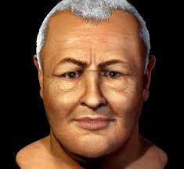
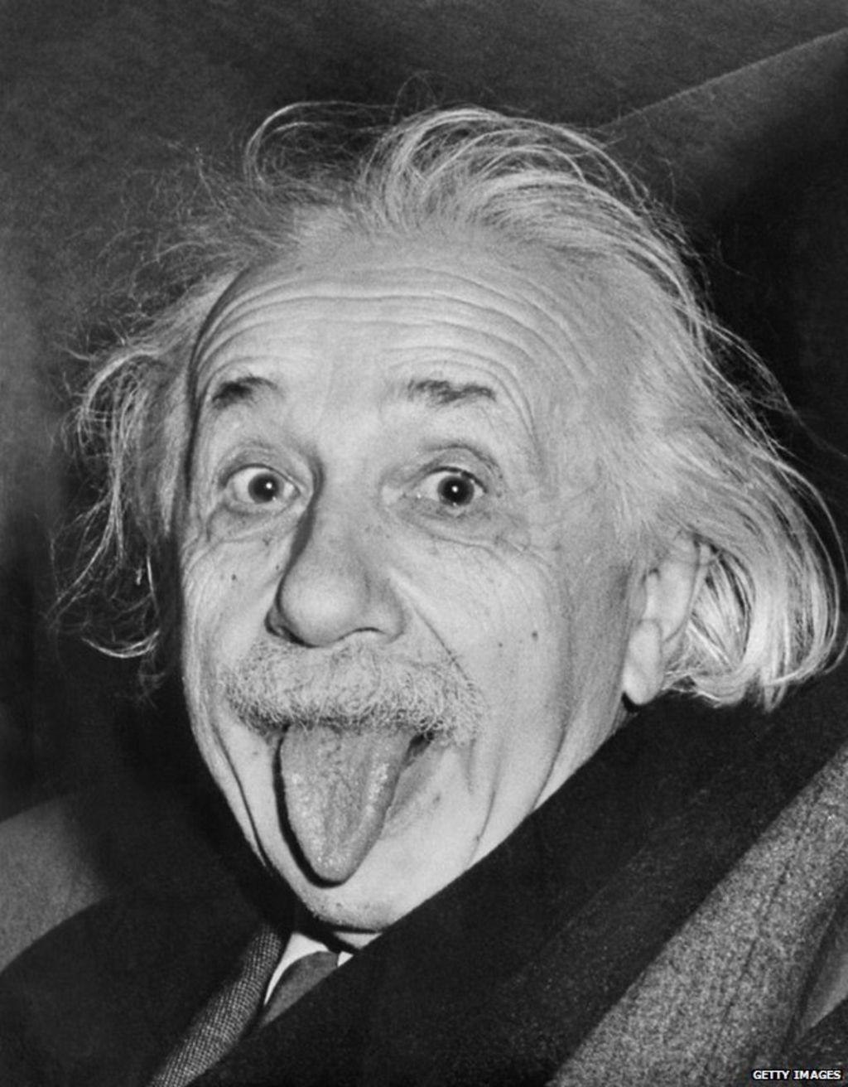
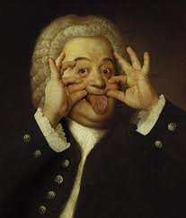
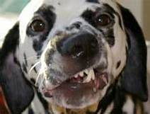
Clef mnemonics
G (treble)
Lines – Every Good Boy Does Fine
Spaces F-A-C-E
F (bass)
Lines – Good Boys Do Fine Always
Spaces – All Cows Eat Grass
Always?
C’est mois!

Slide 5
Oops!... Accidentals
Sharp is #
Double sharp is Ü
Flat is 
Double flat is 

Slide 6
HOMEWORK reminder!
Please listen to the song Ida by the group Axiom of Choice and try to come up with a likely time signature. If that proves too easy, outline the thematic schema by rhythm (A, A, B, A, etc.)
Also try the song Money by Pink Floyd
Hint: neither song is in 4/4

Slide 7
Q: If music is sound, does that mean that sound is music?
A: I know it when I hear it.

Slide 8
How do we hear?
Eh?
Notes:
Short anatomy lesson

Slide 9
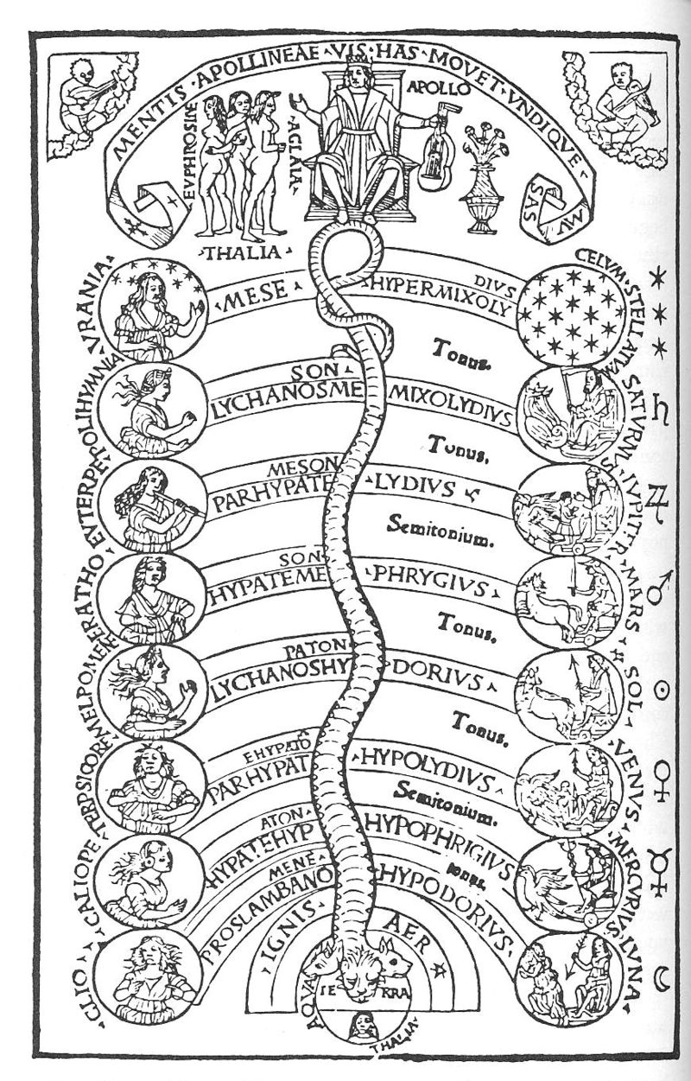
Noisemakers
Living beings, nature
Noise Tools (Instruments)
Air-vibrating
Chordophones (plucked, bowed, or struck strings)
Membranophones (drums)
Aerophones (winds)
Non air-vibrating
Ideophones (concussion, percussion, rattles, etc.)
Musica universalis
Plato - astronomy and music as "twinned" studies of sensual recognition: astronomy for the eyes, music for the ears, and both requiring knowledge of numerical proportions
Music of the Spheres

Slide 10
Good Vibrations
Basic Physics of Sound

Slide 11
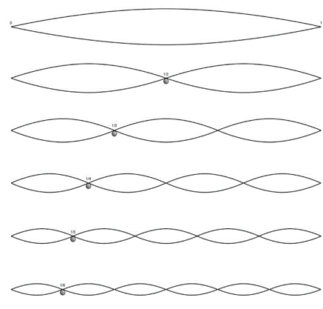
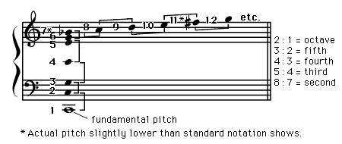
Wavering
Sound waves
Overtones
Nodes
Antinodes
Hertz (Hz)
Intervals
Whole, half steps
P, M, m
Notes:
Show the series on Grand Staff
For intervals, show on fretboard and keyboard

Slide 12
What is meant by “being in tune”, then?
When the planets align
When the nodes align
Strings
Back to aerophones
Sympathetic vibrations
Notes:
Go back one slide and draw a trumpet’s overtones

Slide 13
Octave
First overtone
Tones and semitones
Home base

Slide 14
Just and Equal
Just = natural
Equal = unnatural, but a compromise
Why?
How then?
AA=55, A=110, a=220, a’=440, a’’=880, a’’’=1760, a’’’=3520
Synthetic tuning
Notes:
Use grand staff to show one natural instrument in c and another in g

Slide 15
It is key not to fret
Fretboards
Keyboards
Make your own template
Enharmonics
Notes:
Show octave and 12 half steps on OneNote templates

Slide 16
Home à la mode
Aolis, Doria, Ionia, Locria, Lydia, Phrygia
Ionian – W, W, H, W, W, W, H
Dorian – W, H, W, W, W, H, W
Phrygian – H, W, W, W, H, W, W
Lydian – W, W, W, H, W, W, H
Mixolydian (Dorian/Lydian mix) – W, W, H, W, W, H, W
Aolian – W, H, W, W, H, W, W
Locrian – H, W, W, H, W, W, W
Please refer to https://music.stackexchange.com/questions/11274/what-are-the-greek-modes-and-how-do-they-differ-from-modern-modes
Notes:
Use BB for piano, go quick! Frere Jacques
Ask them to refer to the article for LOTS more

Slide 17
Formulas
Super popular: Major (Ionian) in C
C, D, E, F, G, A, B, C…
W, W, H, W, W, W, H
2nd most popular: Minor (Aeolian) in C
A, B, C, D, E, F, G, A…
W, H, W, W, H, W, W

Slide 18
Your turn
But what if you start on a pitch other than C?
How to draw a piano template
Here’s a major and minor scale based on the starting pitch G:
Major: G, A, B, C, D, E, F#, G
Minor (relative/pure): g, a, b flat, c, d, e flat, f, g
Now you.
Construct 2 major and 2 minor scales using the formula (not by key signature)
Use your keyboard or template
Notes:
Work the g scales on the BB piano

Slide 19
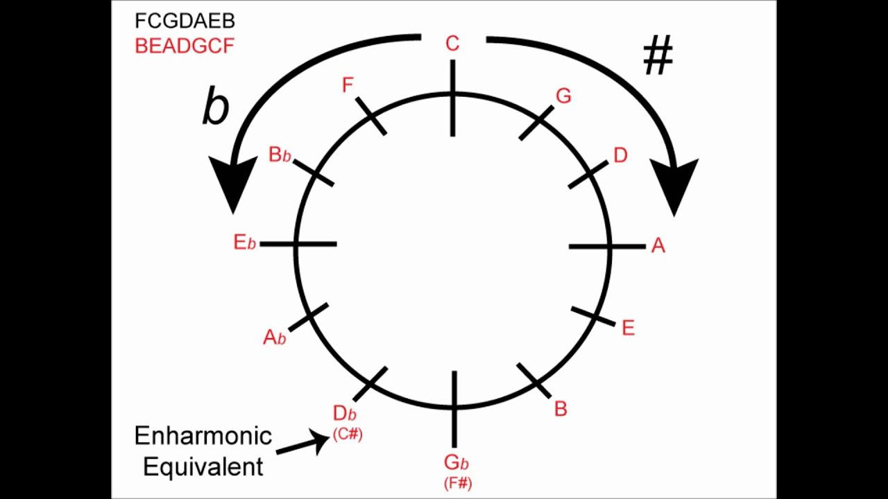
Circle circus
The circle of Fifths
Notes:
Start with #s ascending, bs descending

Slide 20
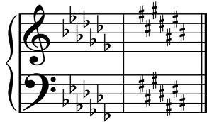
May I take your order?
SHARPS:
FCGDAEB
Fat Cats Get Donuts After Eating Breakfast
FLATS:
BEADGCF
Breakfast Eating After Donuts Gets Cats Fat

Slide 21
Conclusion
Video time

