Slide 1
Music Theory, Act III. Rhythm Etiquette Tuesday, May 5, 2020
https://www.youtube.com/watch?v=lVPLIuBy9CY – 10 minutes
How to Conduct Yourself in Private

Slide 2
Tonight’s Show
Review and Wrap-up of Last Week’s Meeting
Modern Rhythmic Notation (whys and wherefores will come later)
Meter
Rhythm Solfège Options for Modern Bandsfolk

Slide 3
Review and wrap-up
Major scale formula
WWHWWWH
Minor scale formula
WHWWHWW (relative/natural)
Circle of fifths

Slide 4
Speech tempo, patterns, pauses and word stress
“If a word in the dictionary were misspelled, how would we know?” Steven Wright
“When I'm good I'm very, very good, but when I'm bad, I'm better.” Mae West
https://www.youtube.com/watch?v=cxF_V90s9g8 (0:13)
“… “ Marcel Marceau

Slide 5
Bar’s closed
Barlines
Order vs. Chaos
Single
Double
Repeats
Final
Measures (bars)
Timed
Not timed

Slide 6
Notes… they’re here for the duration
Noteheads
Stems
L/R
U/D
Flags/Beams
That pesky x axis…
It is “x”, right?
1$÷$2 $÷$2 $÷$2 $÷$2
Tuplets

Slide 7
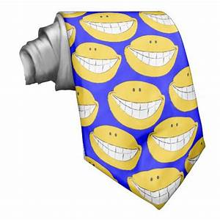
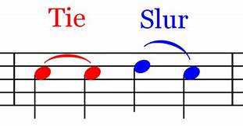
Tie (not slur)

Slide 8
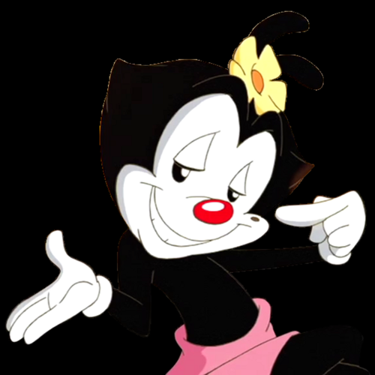
The Dot Rule
… Still, 1$÷$2 $÷$2 $÷$2 $÷$2

Slide 9
Meter (Time Signatures)
How they work
Simple Time Signatures
Compound Time Signatures
Complex Time Signatures
Non-Dyatic/Irrational Time Signatures
8/8 but in 3 feel
4/20

Slide 10
Time Etiquette - How to conduct yourself (in private)
2
3
4
Use a Metronome!!!

Slide 11
Homework turn in
Ida
Others

Slide 12
Rhythm Solfège
Numbers
Eastman (Fr. Variant)
Others (Kodály, Gordon, etc.)
Tuplets

Slide 13
Next Week’s Homework
Exercise 1 - write down the rhythm of the phrase "languages have different rhythms"
Exercise 2 - come up with a short phrase and write down its rhythmic cadence

