Slide 1
How to Conduct Yourself in Private
Gradus ad ACWE, Lesson 4
https://www.youtube.com/watch?v=kfRWbynDGu8

Slide 2
Tonight’s Lesson
Review of Last Week
Interval Wrap-up
Rhythm Solfege
Counting Exercises
Basic Conducting
Tradition is still an unsolved mystery in music notation

Slide 3
Homework Check
Exercise 1 - write down the rhythm of the phrase "languages have different rhythms"
Exercise 2 - come up with a short phrase and write down its rhythmic cadence

Slide 4
Last Week in Review
Notes
(add Rests)
Multiple Rests
Repeat Bars
Quick exercise
Using whole notes, write down a major scale starting on Ab in whichever clef you’d like
Using quarter notes, write down a pure minor scale on Bb using the opposite clef from the previous exercise

Slide 5
Intervals and Interval Mnemonics
Example out there: https://en.wikipedia.org/wiki/Interval_recognition
PP, P4, P5, P8
M2, M3, M6, M7
m2, m3, TT, m6, m7
From bottom
From top
Practice with a drone!

Slide 6
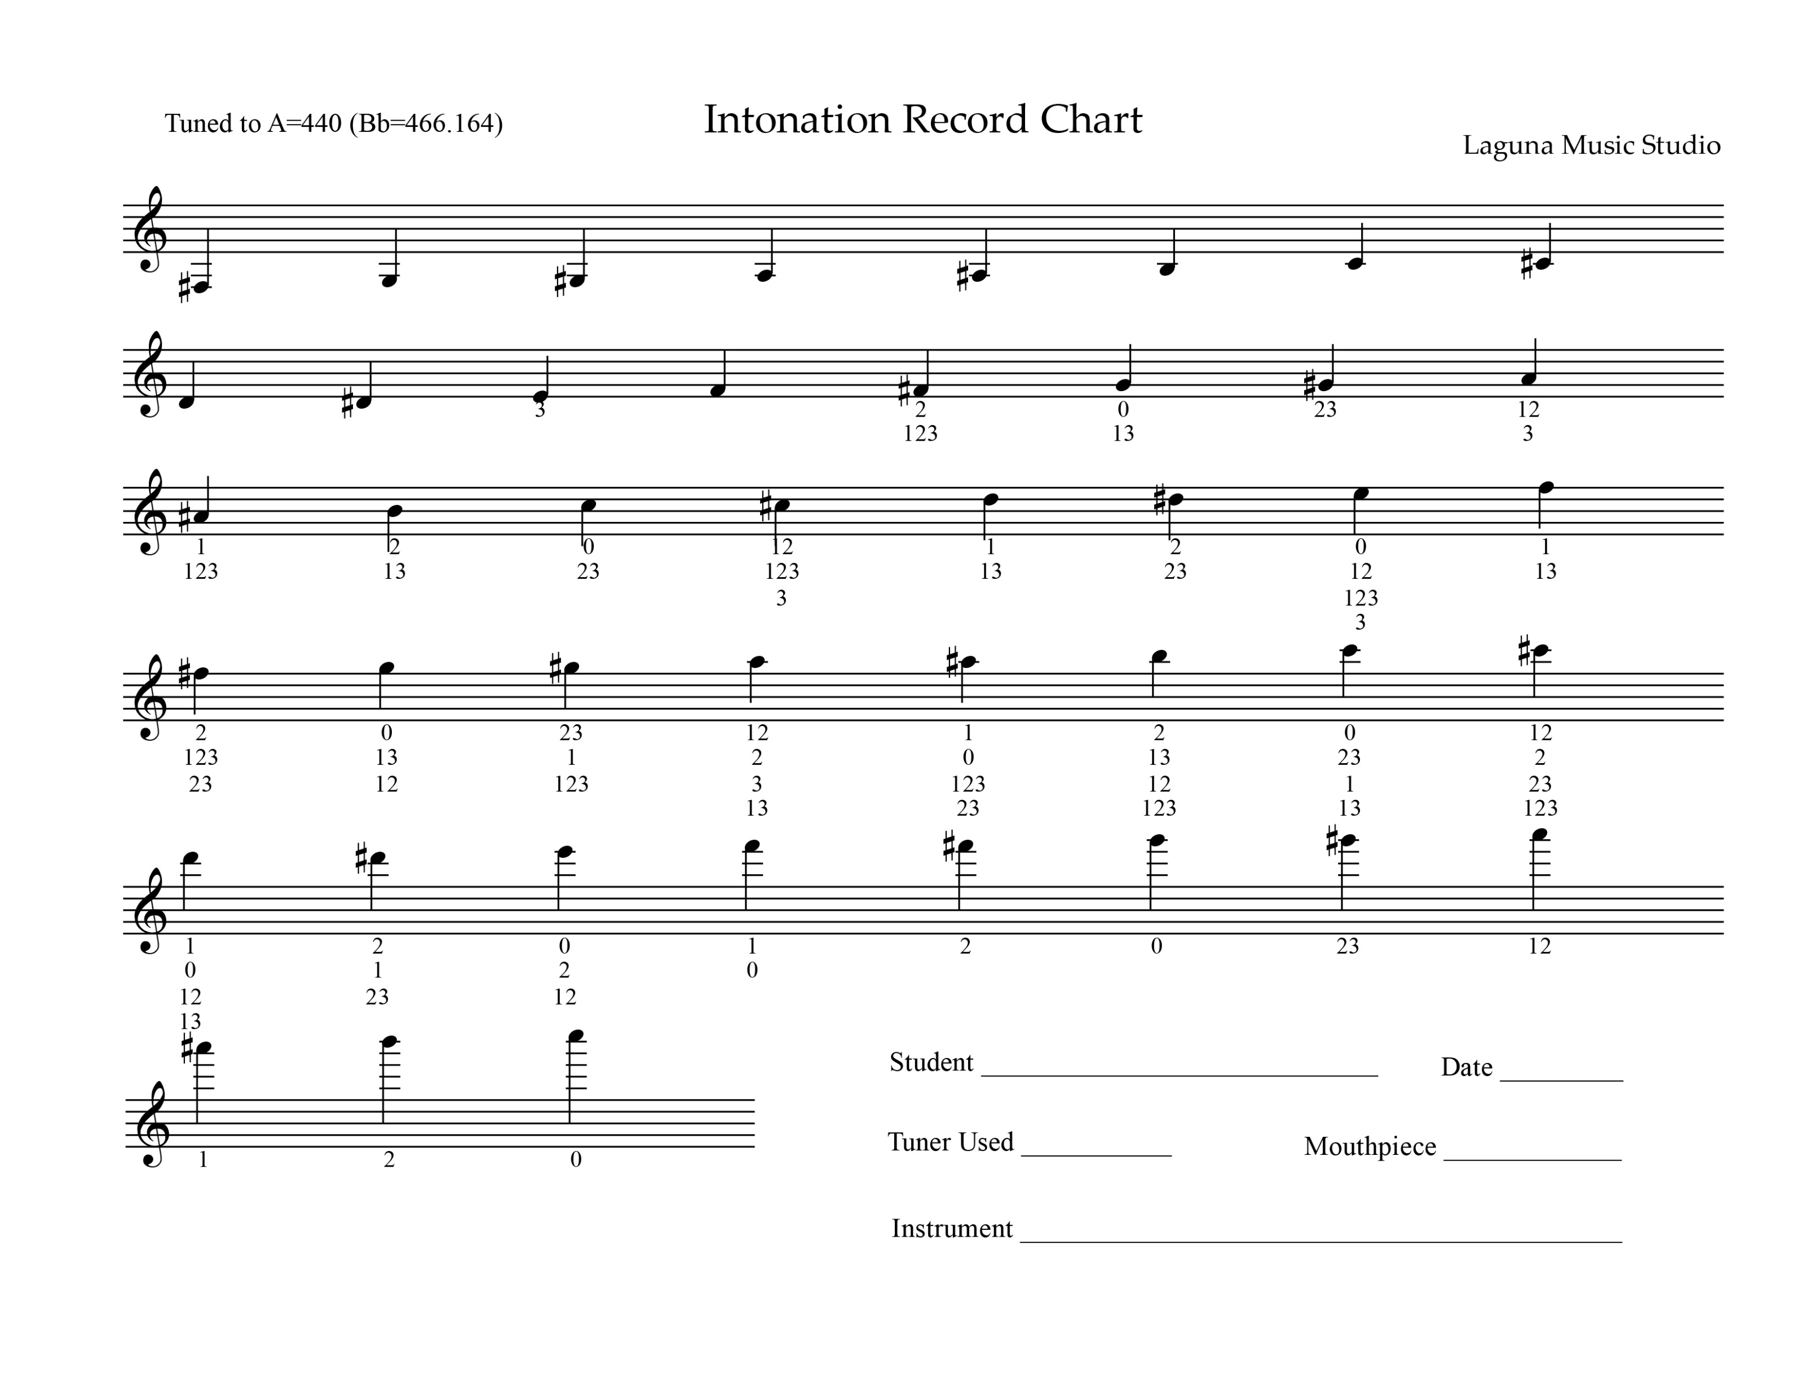
Intonation Chart Sample

Slide 7
Rhythm Solfege
Numbers
Eastman (Fr. Variant)
Others (Kodaly, Gordon, etc.)
Tuplets
More on Time Signatures and Measures

Slide 8
Conducting Redux
1
2
3
4
5?
Tempos (60, 96, 120) lento/adagio, andante, a la marcia
Conducting as an art form? Vocabulary?

Slide 9
Your Turn…
Using “Counting Rhythms with Notes 2” – write, count, conduct 1-10
Using “Counting Rhythms with Notes and Rests 2” – write, count, conduct 1-10

Slide 10
For Next Week…
CR&N2 – 20-30
CR&N&R2 – 20-30

Slide 11
Tradition
Nuances
Ornaments
Styles

