Slide 1
Holy Batchord, Batman!
Gradus ad ACWE Lesson 6

Slide 2
Tonight’s Menu
Review lessons 4/5
Check homework
Review intervals
Intro to polyphony
Intro to chords

Slide 3
Rhythm Review
Counting in simple time signatures
Counting in compound time signatures – tuplets
Check homework – group time

Slide 4
Back to intervals
Consonant vs Dissonant
PP, P5, P4
Major and minor 3, 6
All others are considered dissonant
Perfect
Tritone
Major
Minor
Diminished
Augmented

Slide 5
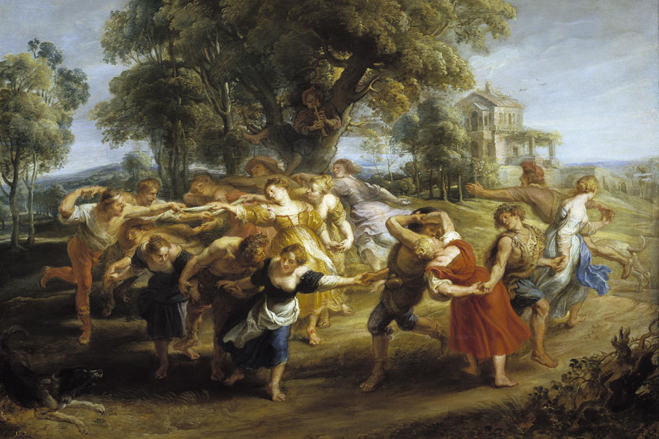
Polyphony (many phonies?)
Early polyphony
Organum
https://youtu.be/F5vqAU_EqG4
Counterpoint
Canons, rounds, fugues
Vertical AND horizontal
Figured Bass
Evolution. Is it progress?
La Folia de la Spagna
Example: Later La Folia (1 part – Finale)
Salieri’s turn: https://www.youtube.com/watch?v=d5EDdlZDEuw
Chordal modern notation in jazz, etc.

Slide 6
Triads
Root position
Inversions

Slide 7
Tetrads
7ths
9ths
Half-diminished

Slide 8
Passing tones in the neighborhood
Passing tones
Apoggiaturas
Neighbors
Anticipations
Suspensions

